Slide 1
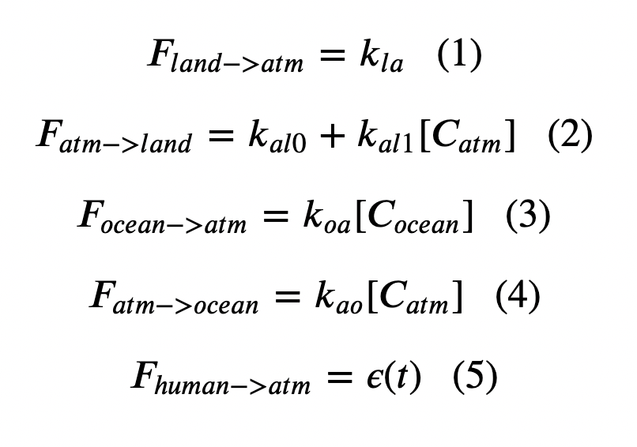
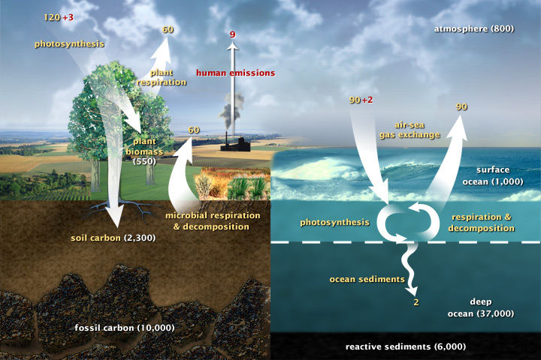
Week 6: Set forth Cambio 1.0 Equations, and how to solve them with Euler’s method
Inside the Euler loop (math):

Slide 2
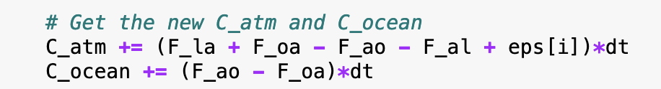
Week 6: Set forth Cambio 1.0 Equations, and how to solve them with Euler’s method
Inside the Euler loop (Python):

Slide 3
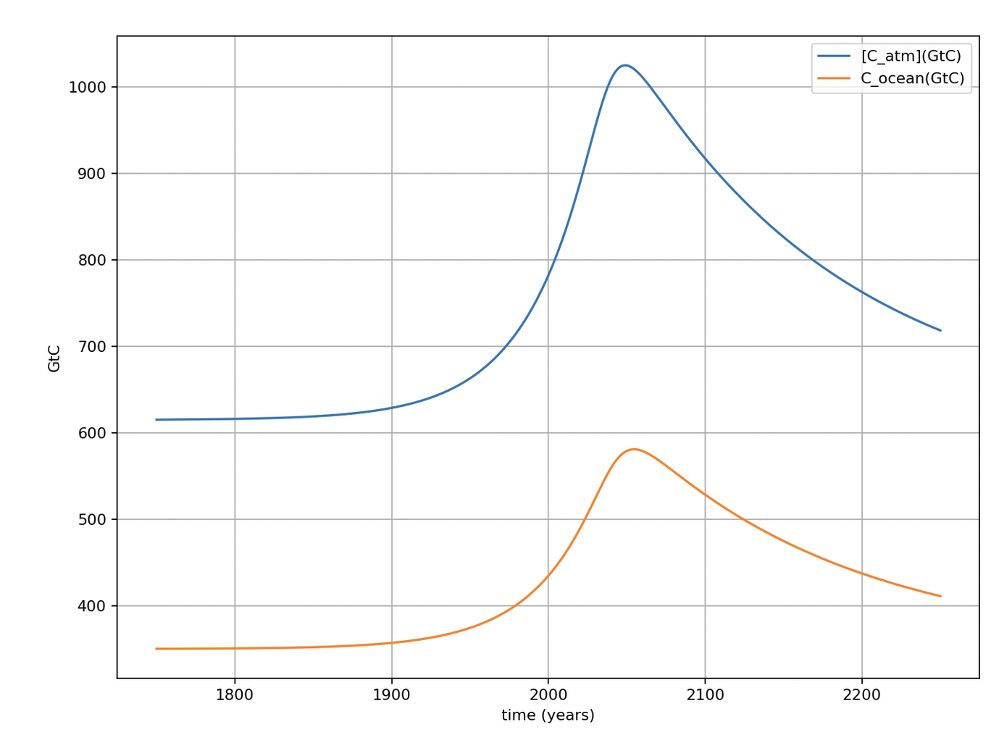
Amounts in the atmosphere and the upper ocean in pre-industrial times
615 GtC in air (pre-industrial)
Pre-industrial carbon amounts
334 GtC in upper ocean (pre-industrial)

Slide 4
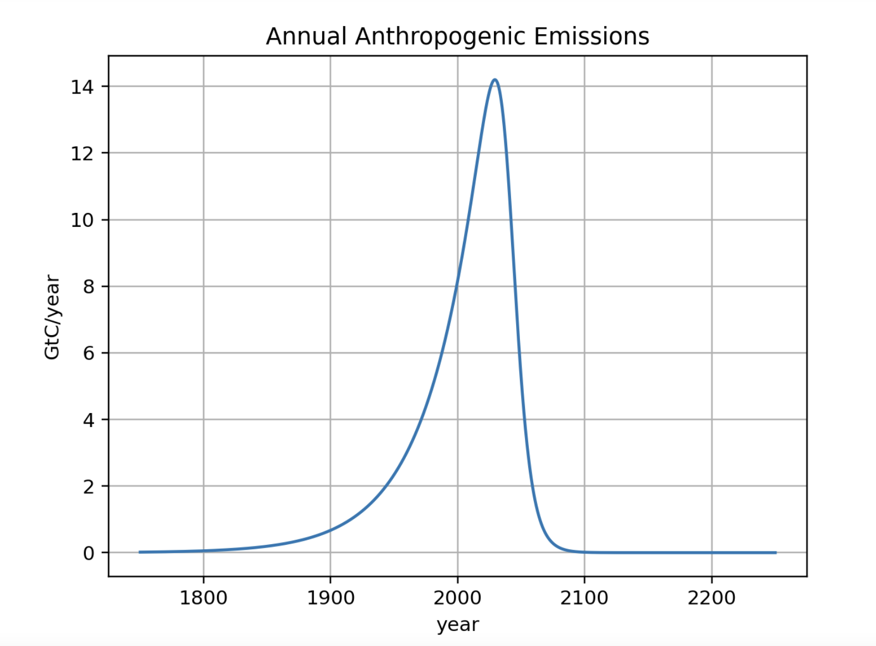
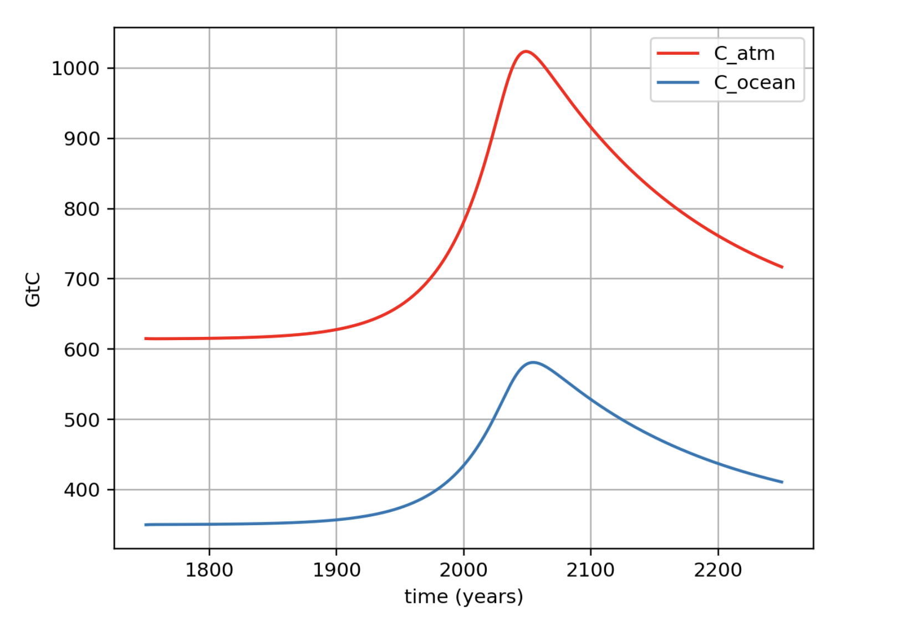
A peek into the output: the time delay between peak emission and peak concentration
For this emissions scenario …
There is this delay …
... here are the amounts of Carbon (GtC) in the climate system.

Slide 5
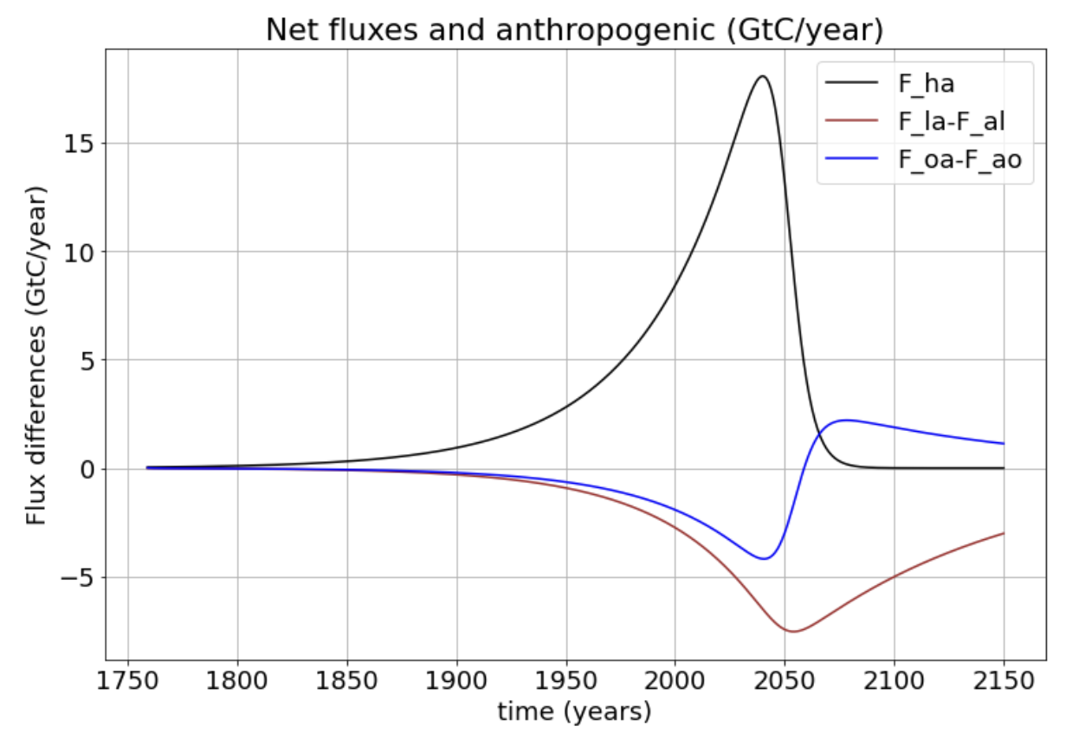
Net fluxes

Slide 6
Net fluxes if you zoom in
9.0 GtC/yr
-2.0 GtC/yr
-3.0 GtC/yr

Slide 7
For comparison with NASA’s Global Carbon Cycle (GCC) diagram
Seems like pretty good agreement!

Slide 8
Net fluxes as a percentage of anthropogenic emission
In the year 2003, the percentage of anthropogenic emissions absorbed by the oceans was about 2.0/9.0=0.22 or 22%.
9.0 GtC/yr
The land absorption (in pink) was about 3.0/9.0=0.33 or 33% of the anthropogenic emission that year.
-2.0 GtC/yr
-3.0 GtC/yr

Slide 9
But oceans will eventually become sources
However, eventually oceans will start to give back their stored CO₂.
So the oceans are more like a lending library for anthropogenic CO₂.

Slide 10
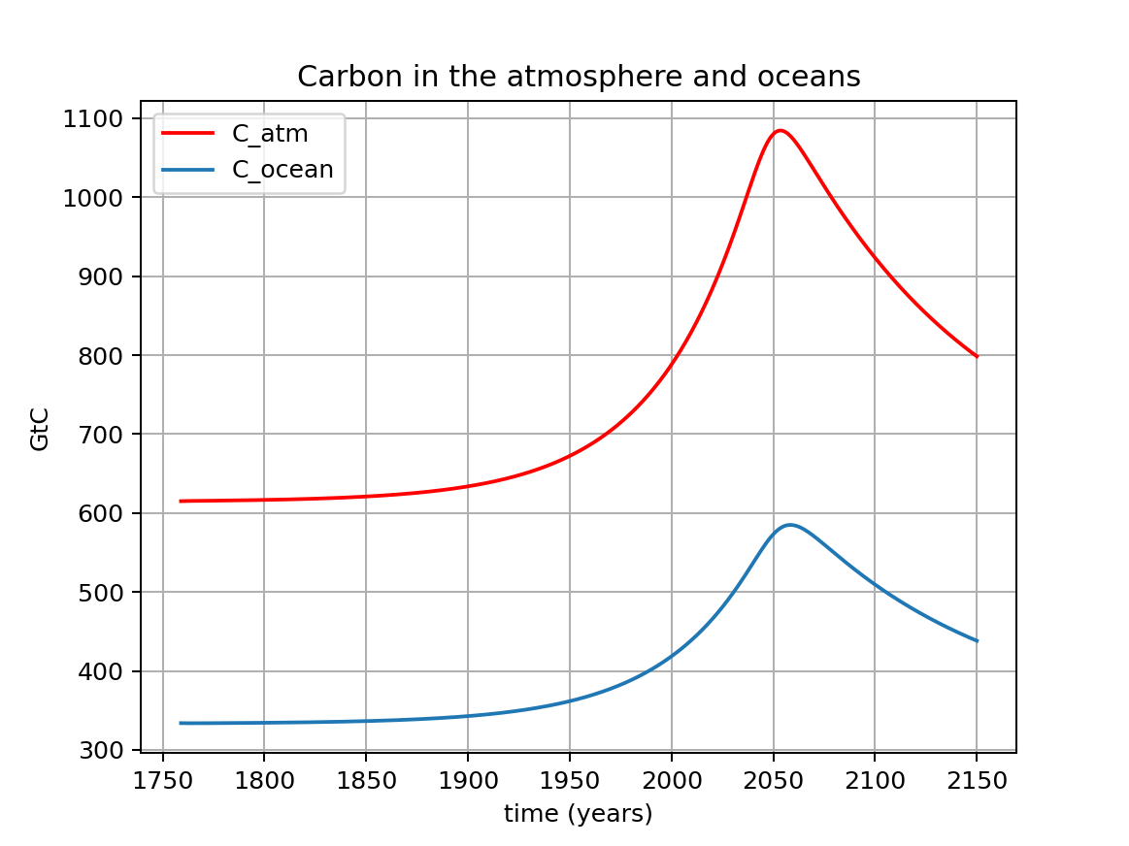
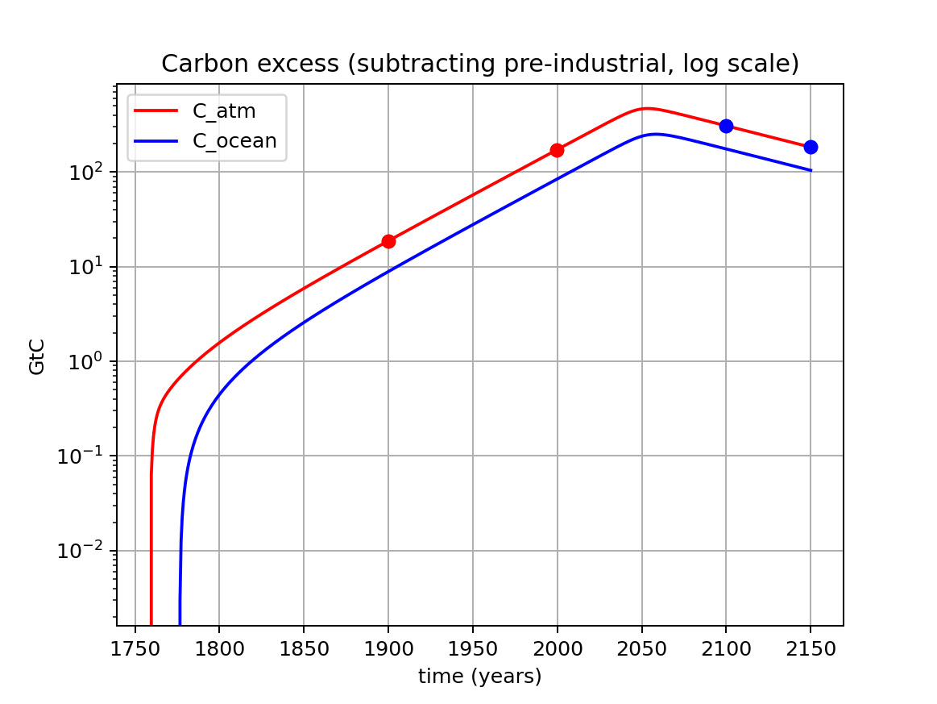
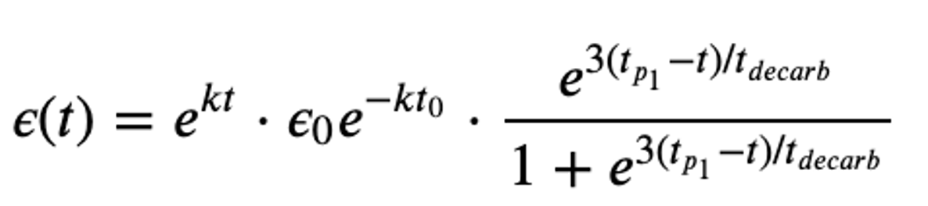
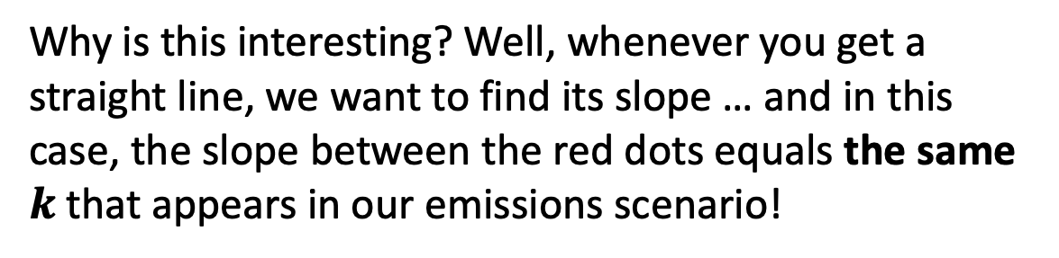
There’s also looking at the excess carbon in the atmosphere and ocean (viewed on a log scale)
Visualizing C_atm and C_ocean in GtC
Visualizing the excess C_atm and C_ocean (that is, however much those values are increased above their pre-industrial amounts) in a log space
Why is this interesting? Well, whenever you get a straight line, we want to find its slope … and in this case, the slope between the red dots equals the same $k$ that appears in our emissions scenario!

Slide 11
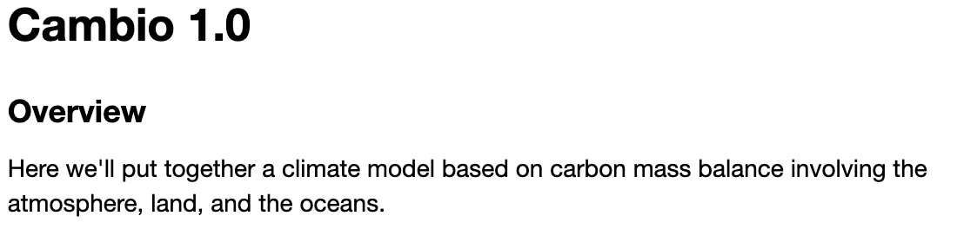
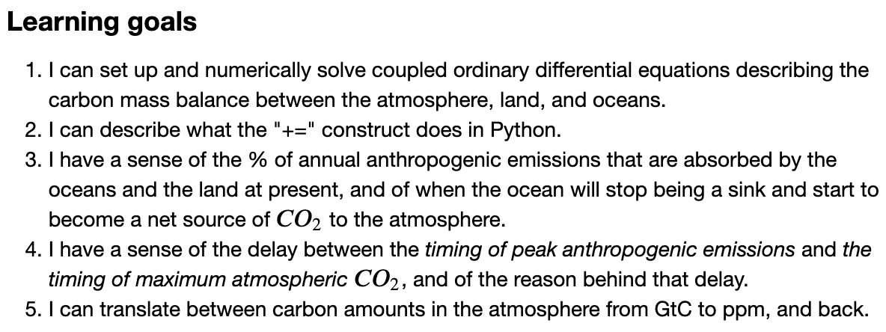
OK, let’s get finish this up

